Slide 1
Capstone project The Battle of Neighborhoods

Slide 2
Introduction
1.1 A description of the problem and a discussion of the background.
Singapore is a multi cultural country. It has a huge variety of different cuisine. Queenstown district has many workplace and thus will definitely have lunch or dinner crowd My friend would like to set up a food store in Singapore around the Queenstown district that is near to transportation mean. I would like to help him to see what type of cuisine is limited or unavaliable in the district. This would allow him to have choices to start his business with the data that is provided.
Information needed:
Singapore Map (Queenstown District)
Type of food in the area
Near to MRT

Slide 3
Data
2.1 Description of the data and its sources
Data will be collected from Foursquare and Wiki
Geographic location of Singapore and the District
Geographic location of Food in the district
Transport Data
Python Lib will be used:
Pandas
Beautiful soup
Geocoder
Folium
matplotlib
Some data are self-made as unable to obtain online. Data such as:
Rental pricing
Rental location
Rental Spaces

Slide 4
Methodology
After the processing of data we will see the data if it answered the following question
The different type of food
What MRT is near
Rental of the Area
Does distance to MRT affect the Rental

Slide 5
Data Type of food
name | categories | lat | lng
0 | Healing Touch | Spa | 1.291318 | 103.807410
1 | No Signboard Braised Duck Noodles | Chinese Restaurant | 1.293188 | 103.802832
2 | Queenstown MRT Station (EW19) | Train Station | 1.294407 | 103.806140
3 | Ah Pang Steamboat & Seafood | Seafood Restaurant | 1.293361 | 103.802559
4 | Ristorante Takada | Italian Restaurant | 1.291396 | 103.807794
5 | 新路 Fishball Noodle | Noodle House | 1.293045 | 103.802903
6 | Cafe Galilee | Café | 1.298478 | 103.805211
7 | Mei Ling Market & Food Centre | Food Court | 1.293007 | 103.803042
8 | Queenstown Stadium | Stadium | 1.296276 | 103.802691
9 | Queenstown Swimming Complex | Pool | 1.296719 | 103.802467
10 | Shi Hui Yuan Hor Fun Specialty | Chinese Restaurant | 1.292921 | 103.803115
11 | Sin Kee Famous Chicken Rice 新记驰名鸡饭 | Chinese Restaurant | 1.293142 | 103.802596
12 | Hai Tang Lor Mee | Food Court | 1.293313 | 103.803092
13 | 7 Stars (Food Court) | Food Court | 1.295043 | 103.810297

Slide 6
Data rental PRICE
Address | Area | Price_per_ft2 | Area-ft2 | Rent_Price | Near_to_MRT
0 | Alexandra Road | Queenstown | 5 | 1000 | 5000.0 | 1
1 | Commonwealth Avenue | Queenstown | 6 | 1100 | 6600.0 | 2
2 | Merino Crescent | Queenstown | 7 | 1000 | 7000.0 | 3
3 | Commonwealth | Queenstown | 9 | 1200 | 10800.0 | 4
4 | Ghim Moh | Queenstown | 11 | 1200 | 13200.0 | 5

Slide 7
Data rental PRICE
Address | Area | Price_per_ft2 | Area-ft2 | Rent_Price | Near_to_MRT
0 | Alexandra Road | Queenstown | 5 | 1000 | 5000.0 | 1
1 | Commonwealth Avenue | Queenstown | 6 | 1100 | 6600.0 | 2
2 | Merino Crescent | Queenstown | 7 | 1000 | 7000.0 | 3
3 | Commonwealth | Queenstown | 9 | 1200 | 10800.0 | 4
4 | Ghim Moh | Queenstown | 11 | 1200 | 13200.0 | 5

Slide 8
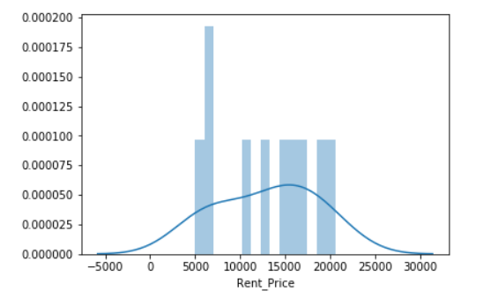
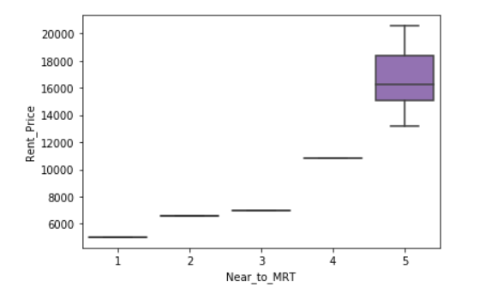
Data

Slide 9
COnclusion
After gathering of datas in regard to the location of Queenstown, we can see that the pricing of the rental is affected by the MRT distance. The distance closer to MRT the more expensive it appears to be. The variety of food that it offered in the area were limited thus i would recommand my friend to open a food store which serve cuisine such as Japanese cuisine or French Cuisine.

